Slide 1
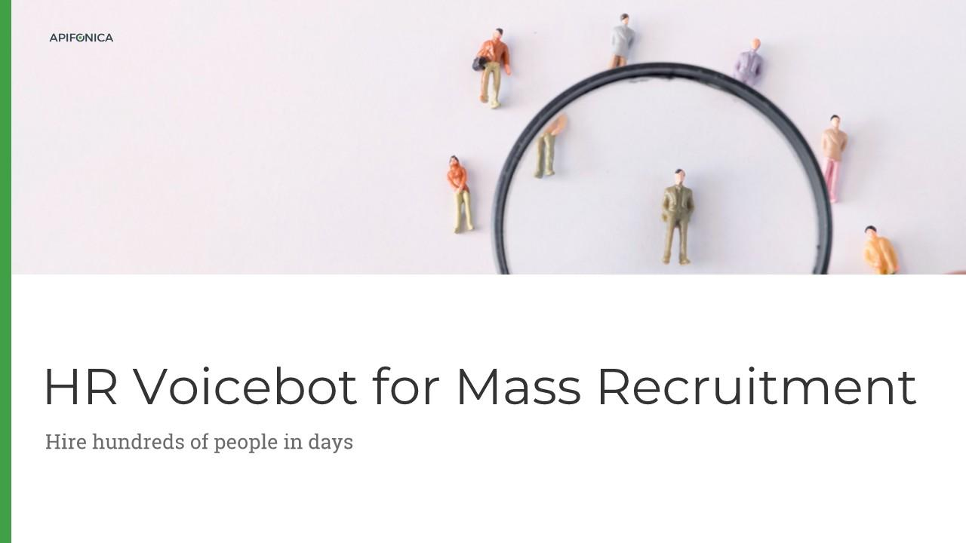

Slide 2
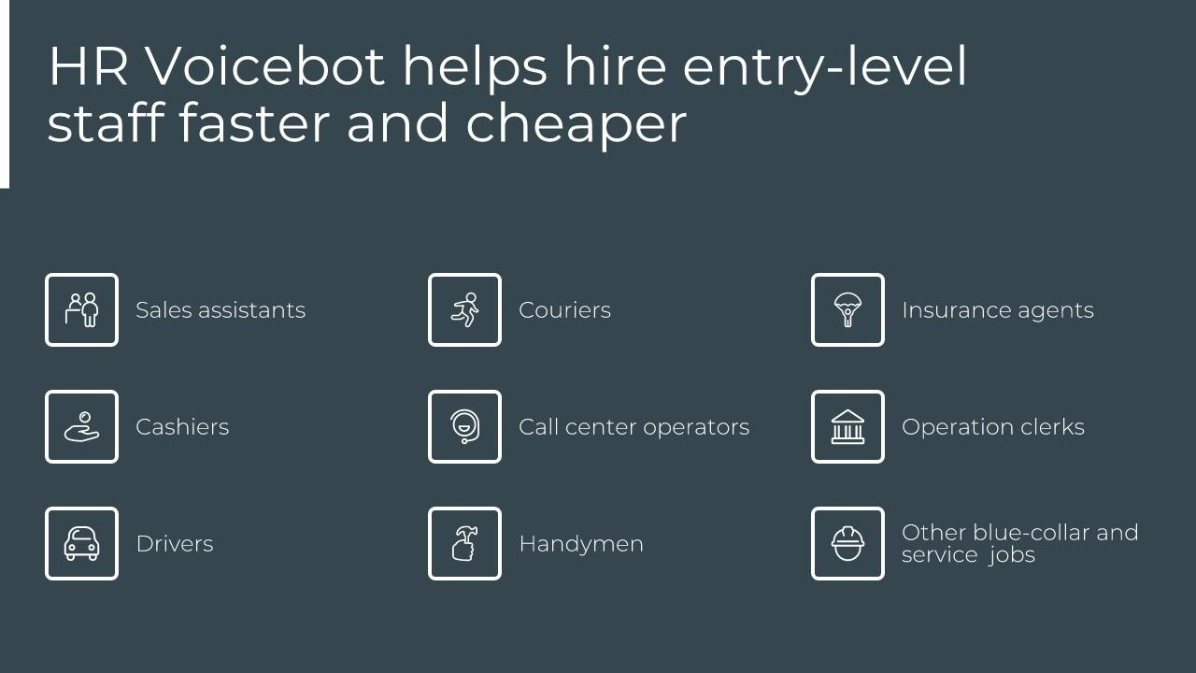

Slide 3
Source: Glassdoor

Slide 4
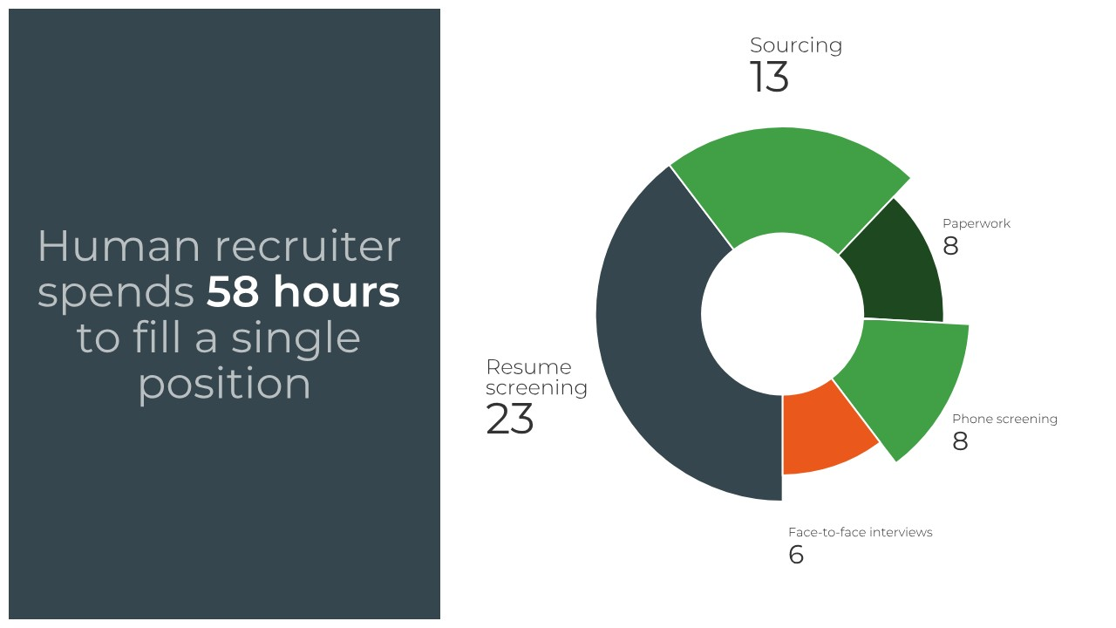
Source: Hire by Google; Jobvite

Slide 5
Saves 76% of the time and 80% of the money spend to fill a position

Slide 7
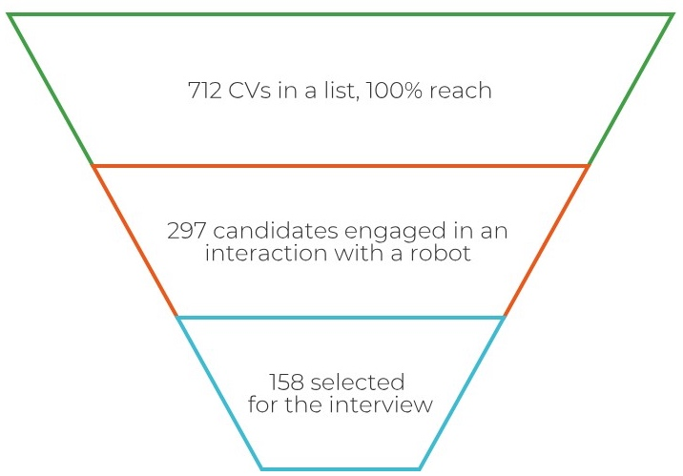
Case study: Automated CV screening
A recruitment and outsourced staffing agency, Finland, May 2019
2 months
€2000
1 hour
€420

Slide 8
Demo: Automated CV screening

Slide 10
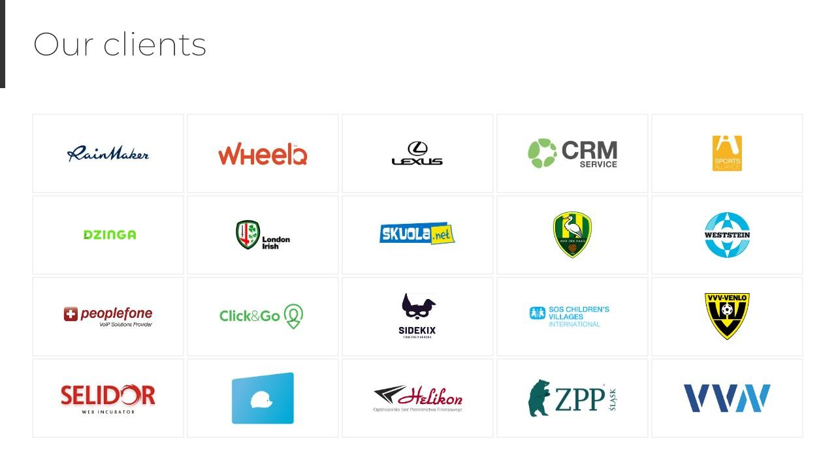

Slide 11
Contact Us
+48 12 446 52 44
https://www.linkedin.com/company/apifonica
apifonica.com
47 J. Vilmsi str., Tallinn, Estonia, 10126

